Slide 1
Pass 1 - Analysis
This part scans the program looking for symbols, labels, variables, etc and organises them in tables
Passes through the instructions in sequence, looking for symbol addresses
Create a symbol and literal table
Keep track of the location counter
Process Pseudo operations(macros / directives?)
Error Checking

Slide 2
start | SET | 50
 | ldc | 20
 | adc | 5
 | ldc | result
 | a2sp
 | adj | 1
val | SET | 75
 | ldc | val
 | stl | 1
triangle | adj | -3
 | adc | -1
 | stl | 1
 | call | triangle
 | ldl | 1
 | stl | 0
result | data | 0
Symbol Table
Literal Table

Slide 3
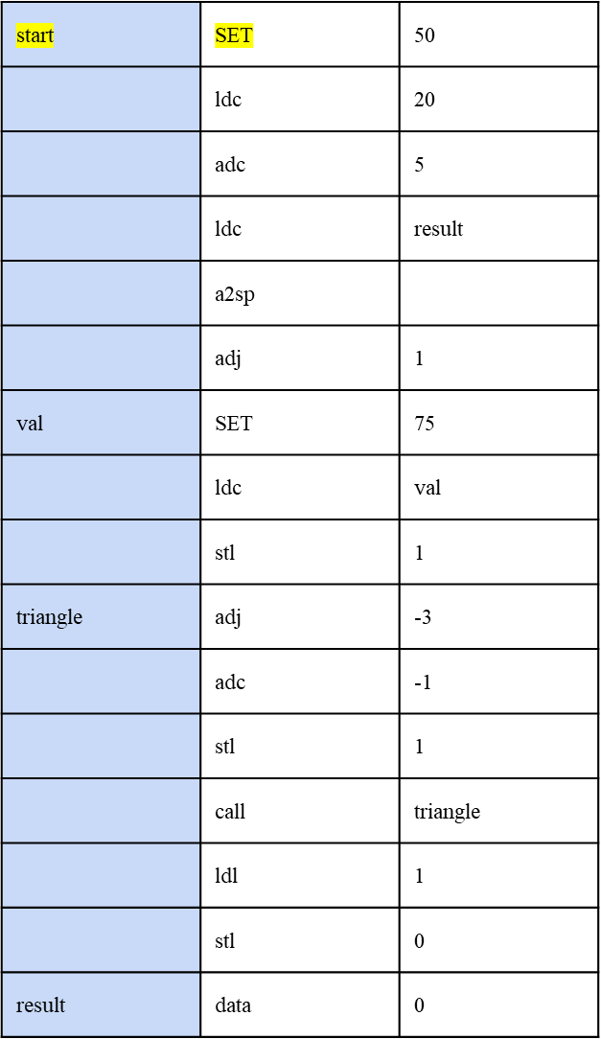
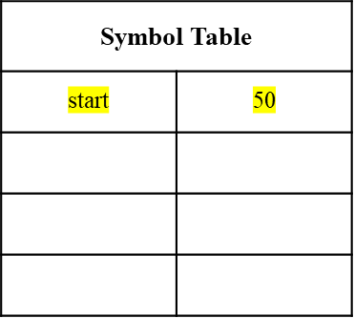

Literal Table

Slide 4
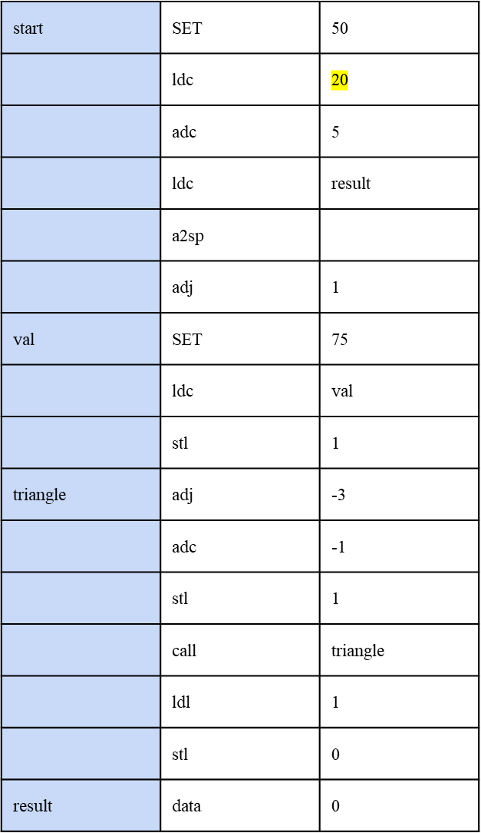
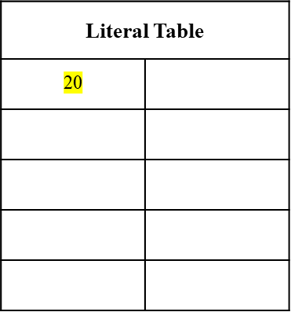
Symbol Table
start | 50

Slide 5
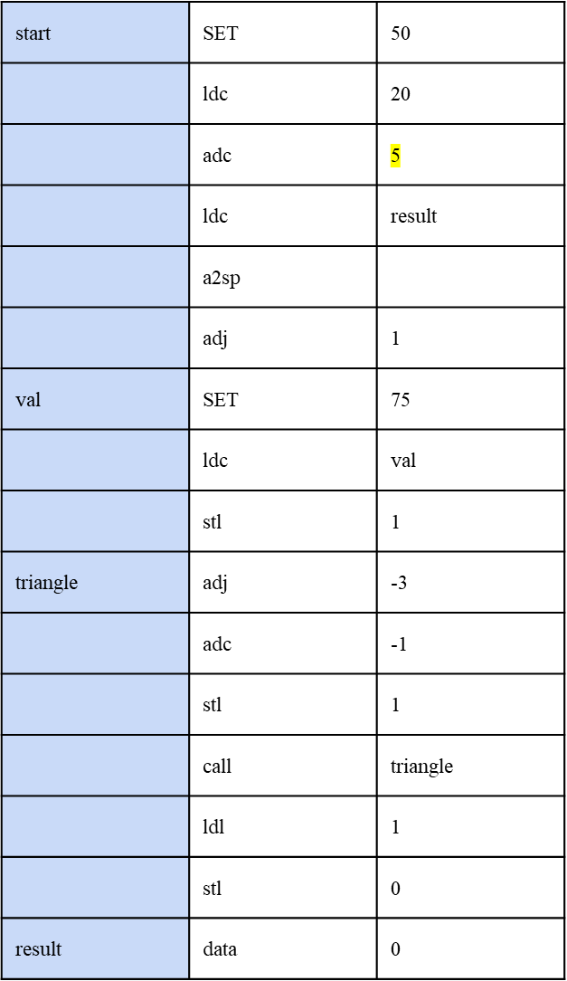
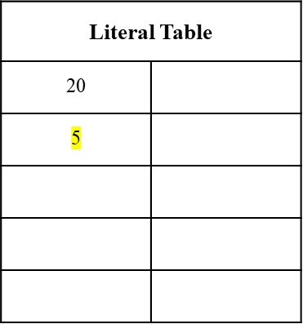
Symbol Table
start | 50

Slide 6
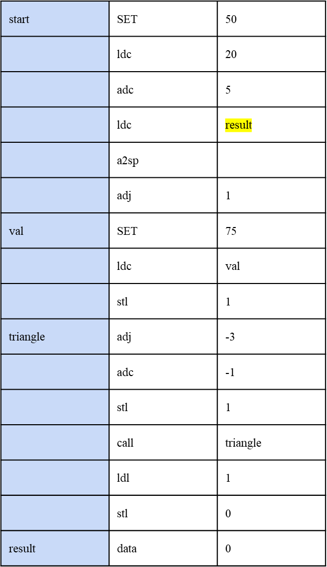
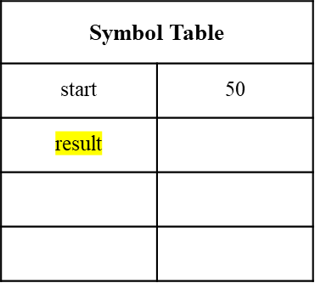
Literal Table
20
5

Slide 7
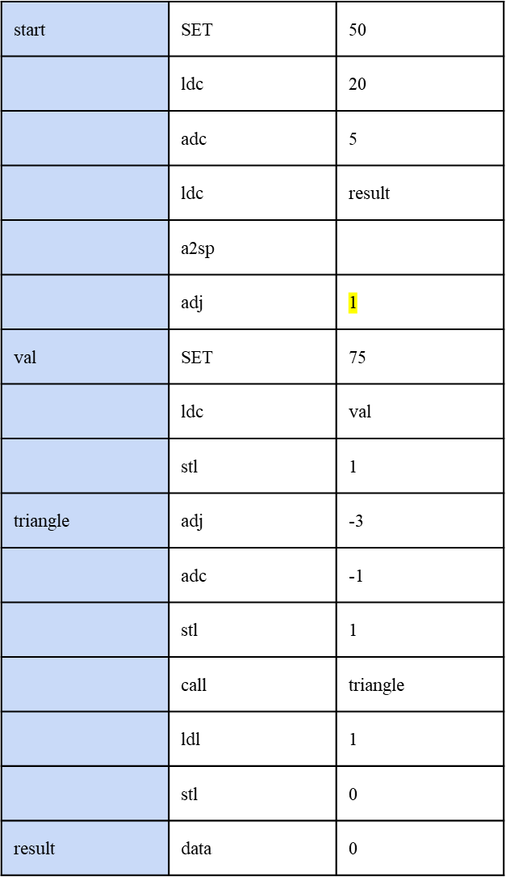
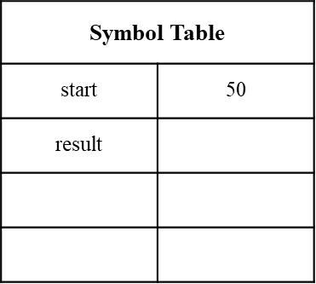
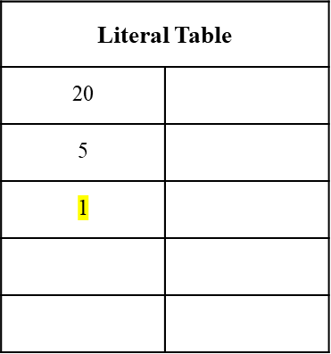

Slide 8
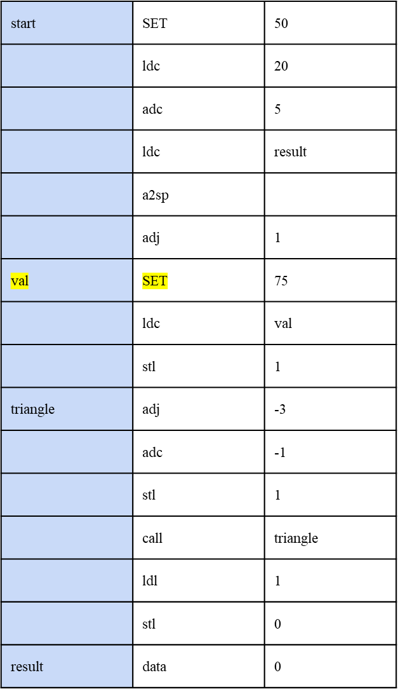
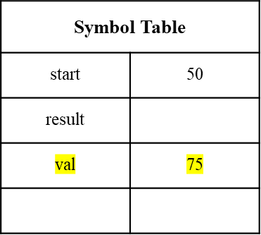
Literal Table
20
5
1

Slide 9
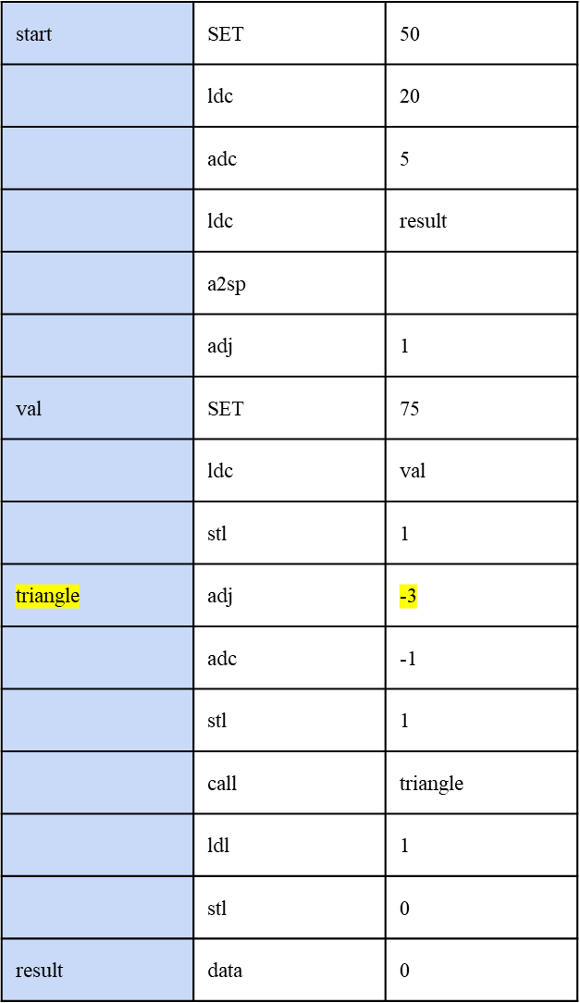
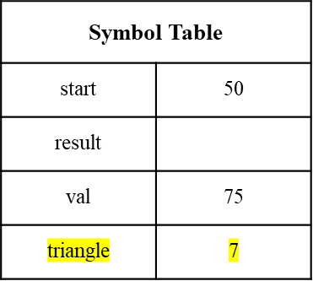
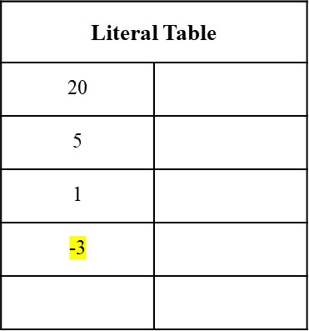

Slide 10
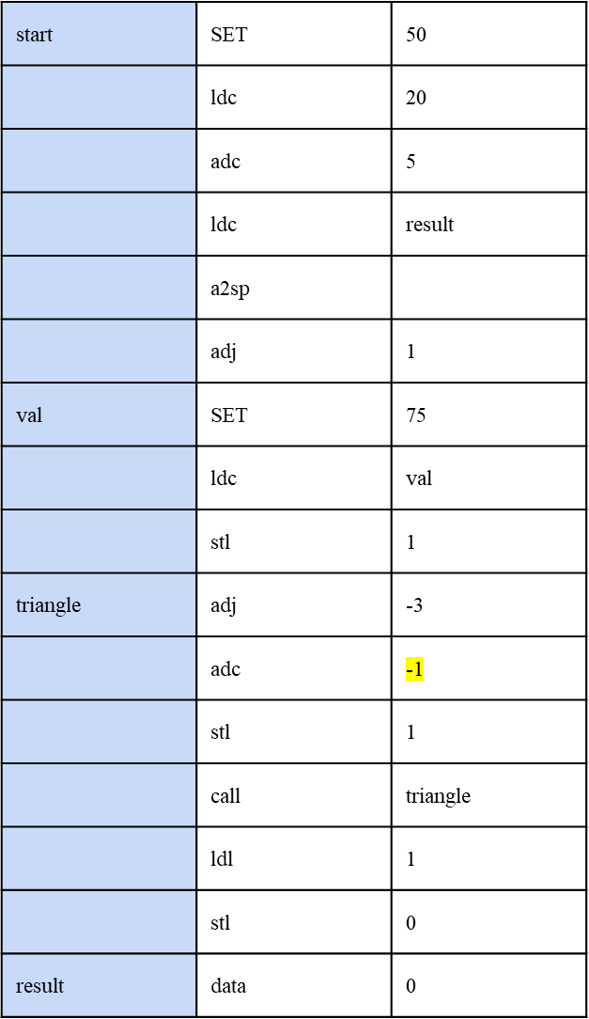
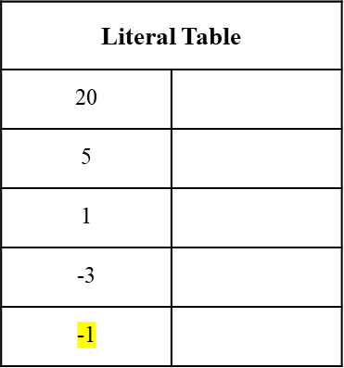
Symbol Table
start | 50
result
val | 75
triangle | 7

Slide 11
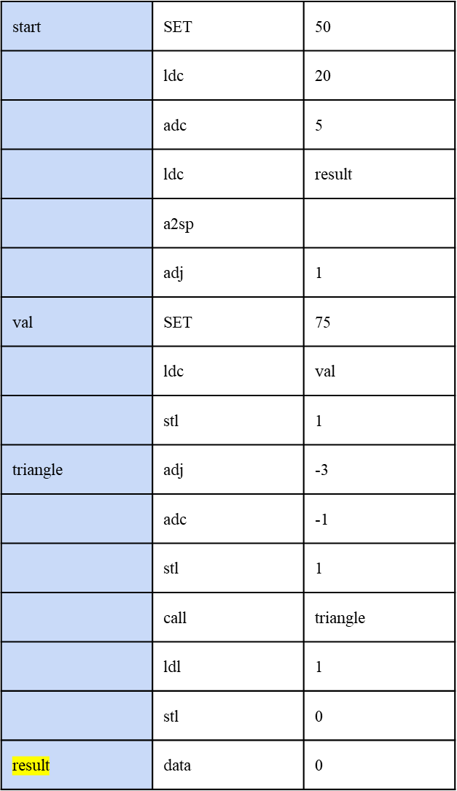
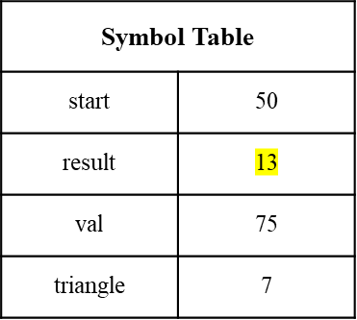
Literal Table
20
5
1
-3
-1

Slide 12
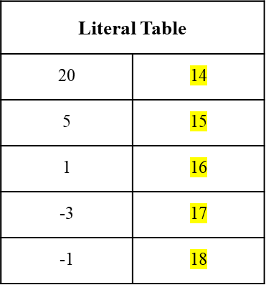
start | SET | 50
 | ldc | 20
 | adc | 5
 | ldc | result
 | a2sp
 | adj | 1
val | SET | 75
 | ldc | val
 | stl | 1
triangle | adj | -3
 | adc | -1
 | stl | 1
 | call | triangle
 | ldl | 1
 | stl | 0
result | data | 0
Symbol Table
start | 50
result | 13
val | 75
triangle | 7

Slide 13
Pass 2
If no errors are found in pass one then the second pass assembles the code into object code.
This process often includes:
Symbolic addresses are replaced with absolute addresses
Symbolic opcodes are replace with binary opcodes

Slide 14
Generation of machine Code
Machine code consists of 32 bits, Commonly comprised of concatenation of 24 bit operand code and 8 bit opcode of that mnemonic.
Exceptions:
i)For the case of Data machine code is just the operand code of 32 bits. Since, the opcode for the mnemonic data is “NULL”.
ii)For the case of SET we simply skip the printing of machine code in object file.

Slide 15
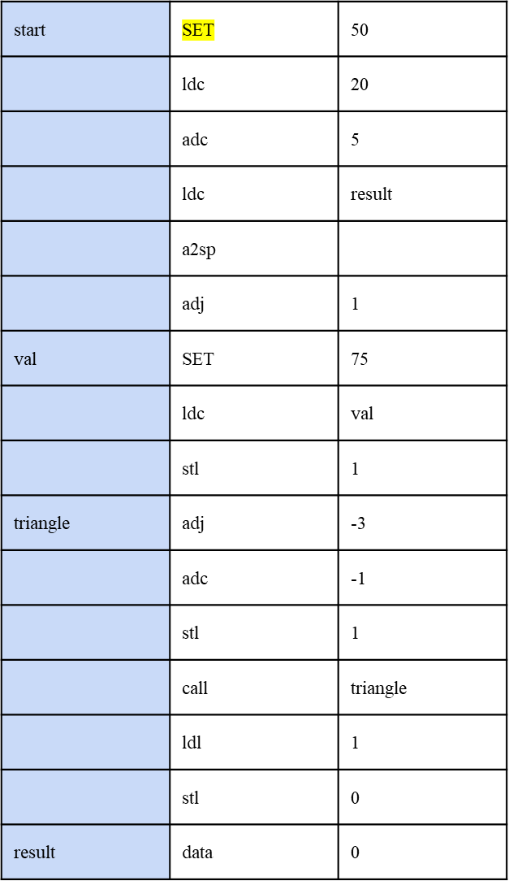
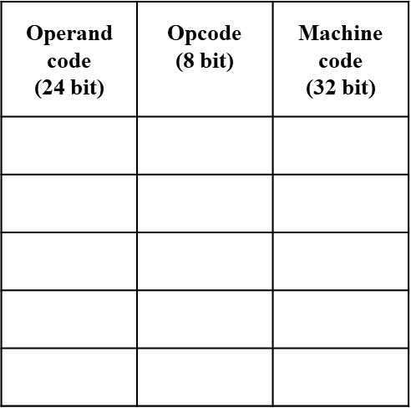
* Since, the mnemonic is SET we wont won’t write anything in the object
file*
*Note: For illustration purpose we used the represented hexadecimal notation for space consideration considerations.

Slide 16
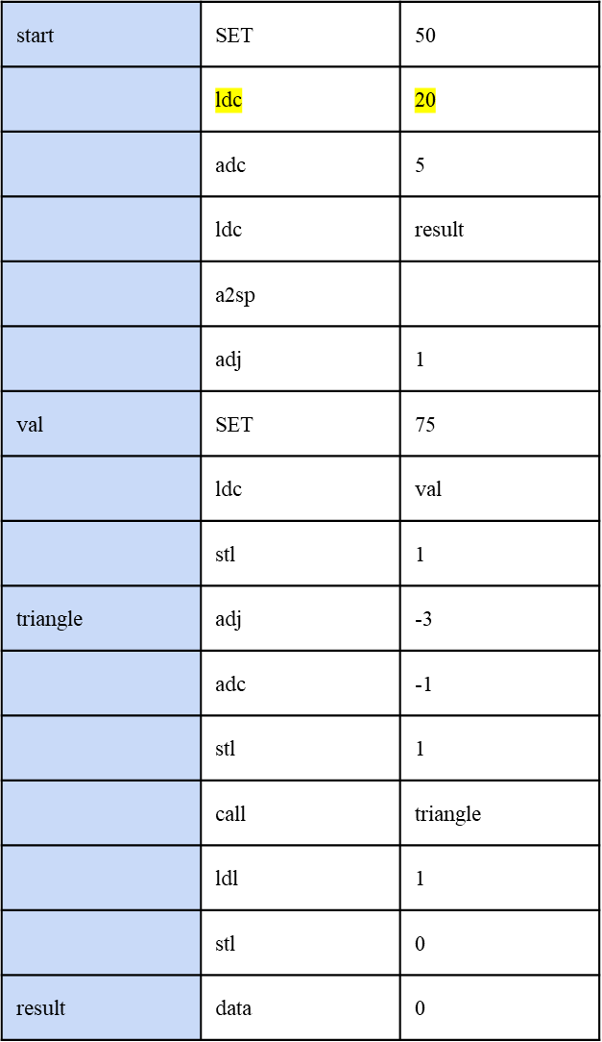
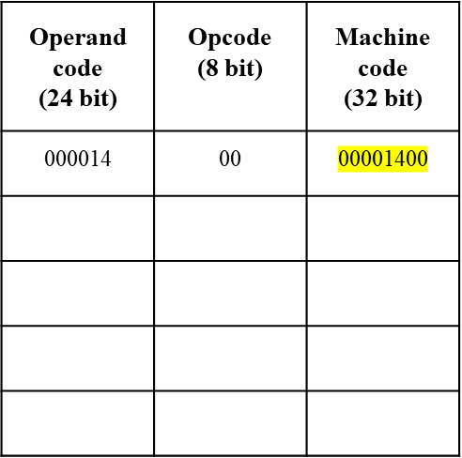
* Since, the opcode of mnemonic is SET we wont ldc is 0 and the operand is 20* object

Slide 17
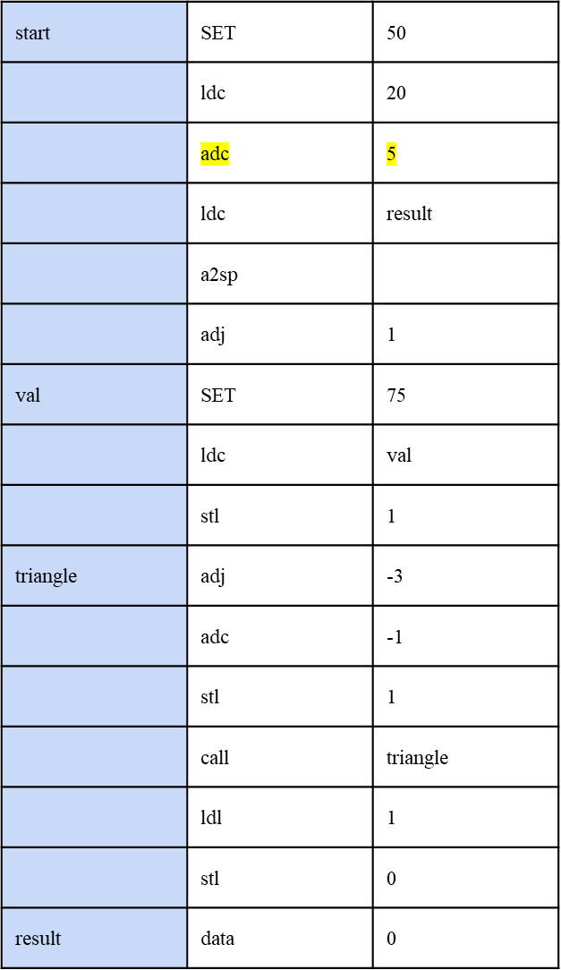
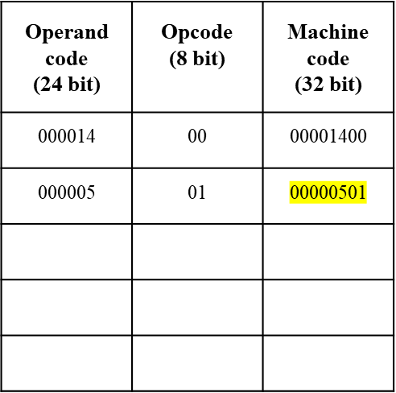
* Since, the opcode of mnemonic is SET we wont adc is 1 and the operand is 5* object

Slide 18
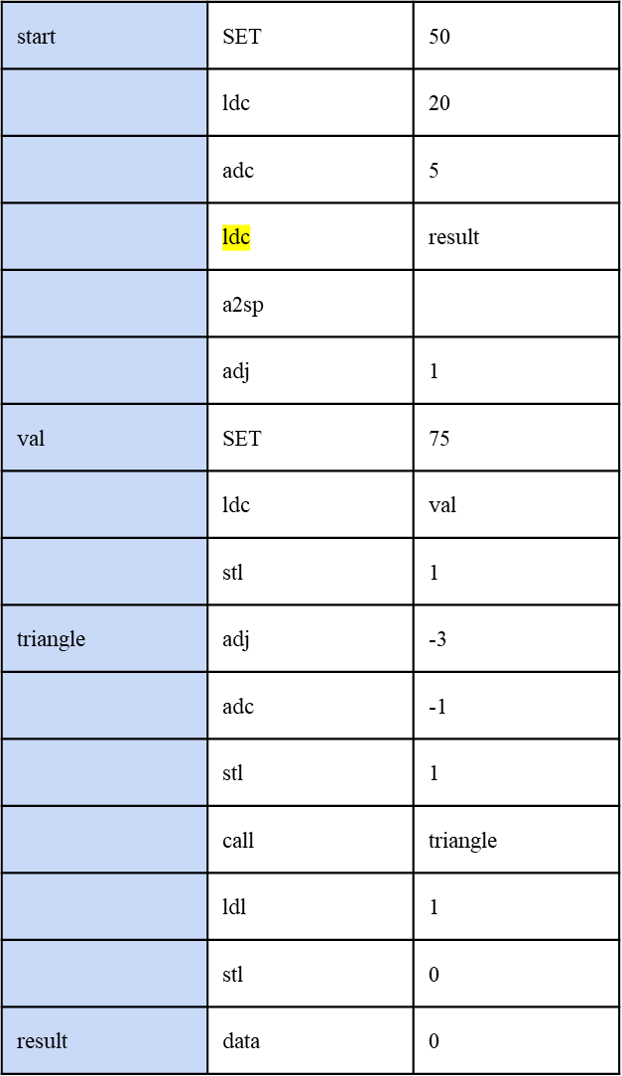
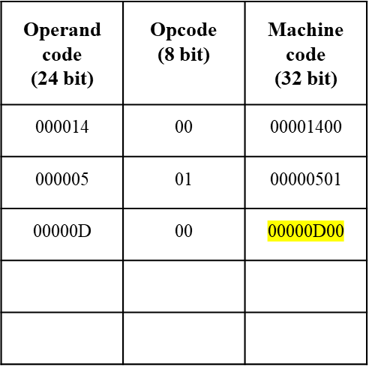
* Since, the opcode of mnemonic is SET we wont ldc is 0 and the operand is a vali* object valid label then the label address
in the symbol table is the operand operand code*

Slide 19
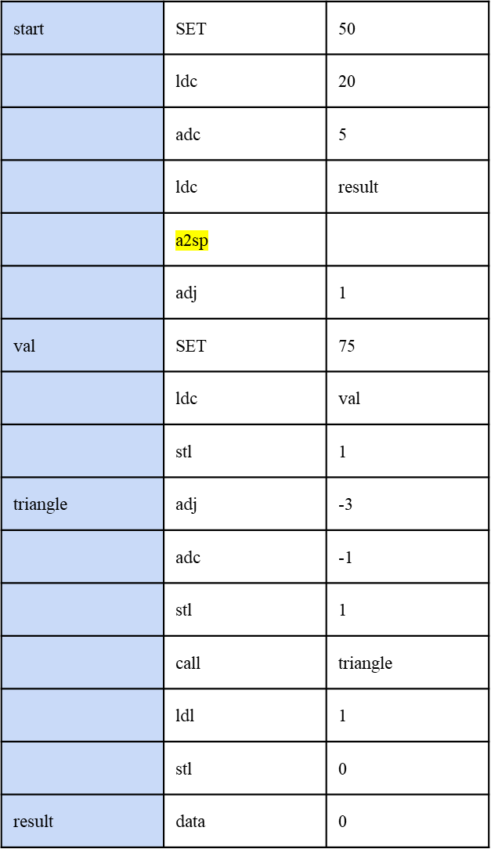
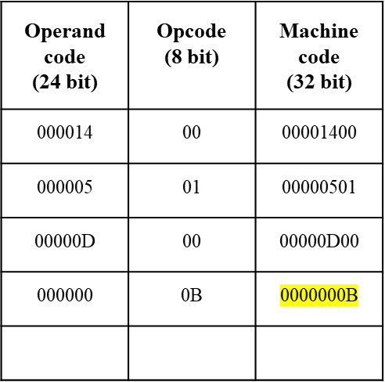
* Since, the opcode of mnemonic is SET we wont a2sp is 11 and it doesn’t require object any operand so the operand code is valid label then the labe is 0*
*

Slide 20
Similary, we can extend the approach ,line by line till the end of the program and can get the final machine code of 32 bits in object file.
Final machine code
00000000000000000001010000000000
00000000000000000000010100000001
00000000000000000000110100000000
00000000000000000000000000001011
00000000000000000000000100001010
00000000000000000100101100000000
00000000000000000000000100000011
11111111111111111111110100001010
00000000000000000000000100000011
11111111111111111111111100000001
11111111111111111111110000001101
00000000000000000000000100000010
00000000000000000000000000000011
00000000000000000000000001100100

